Slide 1
Spring Cloud
Ayan Sengupta

Slide 2
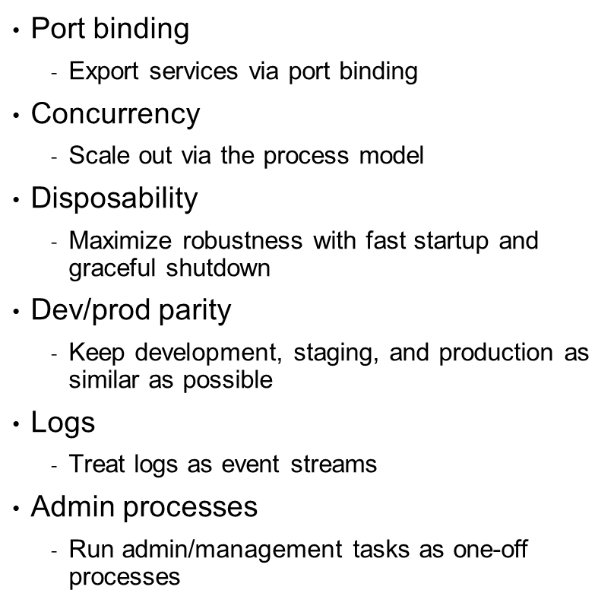
The Twelve-Factor App (from 12factor.net)
Codebase
One codebase tracked in revision control, many deploys
Dependencies
Explicitly declare and isolate dependencies
Config
Store config in the environment
Backing services
Treat backing services as attached resources
Build, release, run
Strictly separate build and run stages
Processes
Execute the app as one or more stateless processes

Slide 3

Spring Cloud
Common features required by all the components in a distributed system
Distributed/versioned configuration
Service registration and discovery
Routing
Service-to-service calls
Load balancing
Circuit Breakers
Global locks
Leadership election and cluster state
Distributed messaging

Slide 4
Spring Cloud Components
Configuration
Service Discovery
Circuit Breakers
Routing and Messaging
API Gateway
Tracing
CI Pipeline and Testing

Slide 5
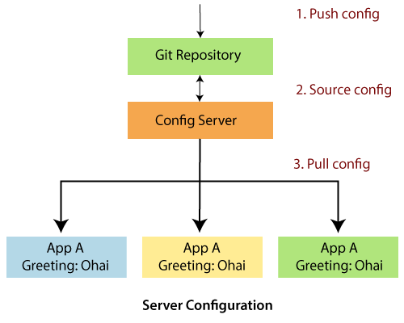
Spring Cloud Configuartion
Spring Cloud Config Server features:
HTTP, resource-based API for external configuration (name-value pairs, or equivalent YAML content)
Encrypt and decrypt property values (symmetric or asymmetric)
Config Server
@EnableConfigServer
spring.cloud.config.server.git.uri=ssh://localhost/config-repo
Config Client
On the client app we can add
spring.cloud.config.uri = <config server uri>

Slide 6
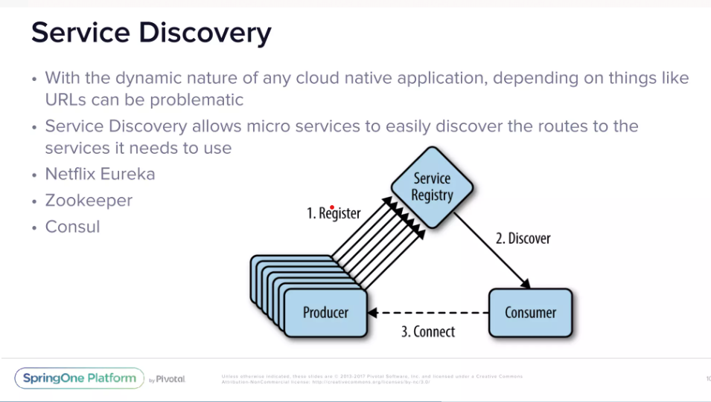
Netflix Eureka (older)
Eureka Server
@EnableEurekaServer
eureka.client.register-with-eureka=false
eureka.client.fetch-registry=false
server.port=8761 (default)
Client App
@EnableEurekaClient
spring.application.name=app-name
eureka.client.register-with-eureka=true
eureka.client.fetch-registry=true
eureka.client.serviceUrl.defaultZone:
http://localhost:8761/eureka
instance.hostname=localhost
Spring Cloud Consul (newer) - Hashicorp Consul
Service Discovery: instances can be registered with the Consul agent and clients can discover the instances using Spring-managed beans
Supports Spring Cloud LoadBalancer - a client side load-balancer provided by the Spring Cloud project
Supports API Gateway, a dynamic router and filter via Spring Cloud Gateway
Distributed Configuration: using the Consul Key/Value store
Control Bus: Distributed control events using Consul Events

Slide 7
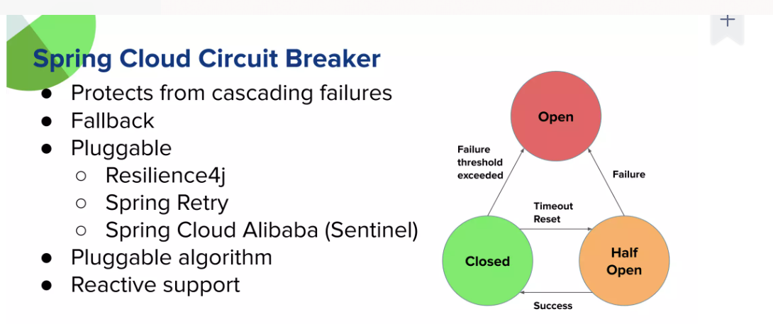
Circuit Breaker
Spring Retry (new) allows applications to retry a failed operation automatically.
Use @EnableRetry on the app then we have two options…
Using @Retryable annotation
Using RetryTemplate
Hystrix (this is old now)
Two ways :
In the micro service code use @HystrixCommand(fallbackMethod = "defaultMethod") and annotate the consumer app @EnableCircuitBreaker
In the API Gateway yaml file we can add CircuitBreaker filters to redirect to fallbackuri
For dashboard we can use @EnableHystrixDashboard
Resilience4j (new) Retry we can register a custom global RetryConfig with a RetryRegistry builder.
Spring Cloud Circuit breaker provides an abstraction across different circuit breaker implementations like Spring Retry and Resilience4j to provide consistent API. Here we use CircuitBreakerFactory or ReactiveCircuitBreakerFactory

Slide 8
Routing and Load Balancing
Netflix Ribbon (old) is outdated now
Spring Cloud Open Feign
Feign is a declarative web service client. Spring Cloud integrates Eureka, Spring Cloud CircuitBreaker, as well as Spring Cloud LoadBalancer to provide a load-balanced http client when using Feign.
Spring Cloud Load Balancer (new)
implement ServiceInstanceListSupplier to define how we find available service instances
next create a WebClient bean by injecting this configuration using @LoadBalancerClient and declaring the bean as @LoadBalanced
use this load balanced WebClient bean in the client app to call the service

Slide 9
API Gateway
Route: These are the building blocks of the gateway which contain URL to which request is to be forwarded to and the predicates and filters that are applied on the incoming requests.
Predicate: These are the set of criteria which should match for the incoming requests to be forwarded to internal microservices. This lets you match on anything from the HTTP request, such as headers or parameters.
Filter: These act as the place where you can modify the incoming requests before sending the requests to the internal microservices or before responding back to the client.
Zuul (old) supports blocking api calls only
Spring Cloud Gateway aims to provide a simple, yet effective way to route to APIs and provide cross cutting concerns to them such as: security, monitoring/metrics, and resiliency.
Features
Built on Spring Framework and Spring Boot
Able to match routes on any request attribute.
Predicates and filters are specific to routes.
Circuit Breaker integration.
Spring Cloud DiscoveryClient integration
Easy to write Predicates and Filters
Request Rate Limiting
Path Rewriting
Sample gateway configuration
spring:
cloud:
gateway:
routes:
- id: baeldung_route
uri: http://baeldung.com
predicates:
- Path=/baeldung/
filters:
-AddResponseHeader=X-Custom_Header,Custom Value

Slide 10
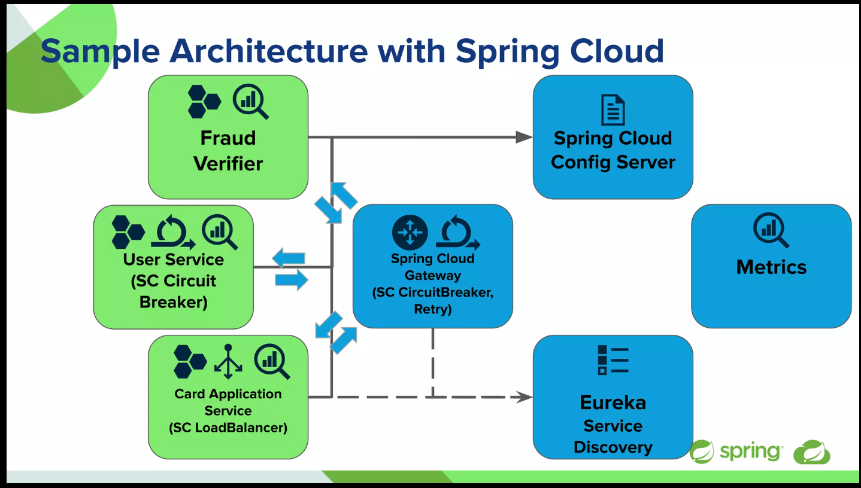
API Gateway
Important : Spring Cloud Gateway can incorporate components like circuit breaking, routing, Api gateway and tracing but you still need a config server and service discovery service separately

Slide 11
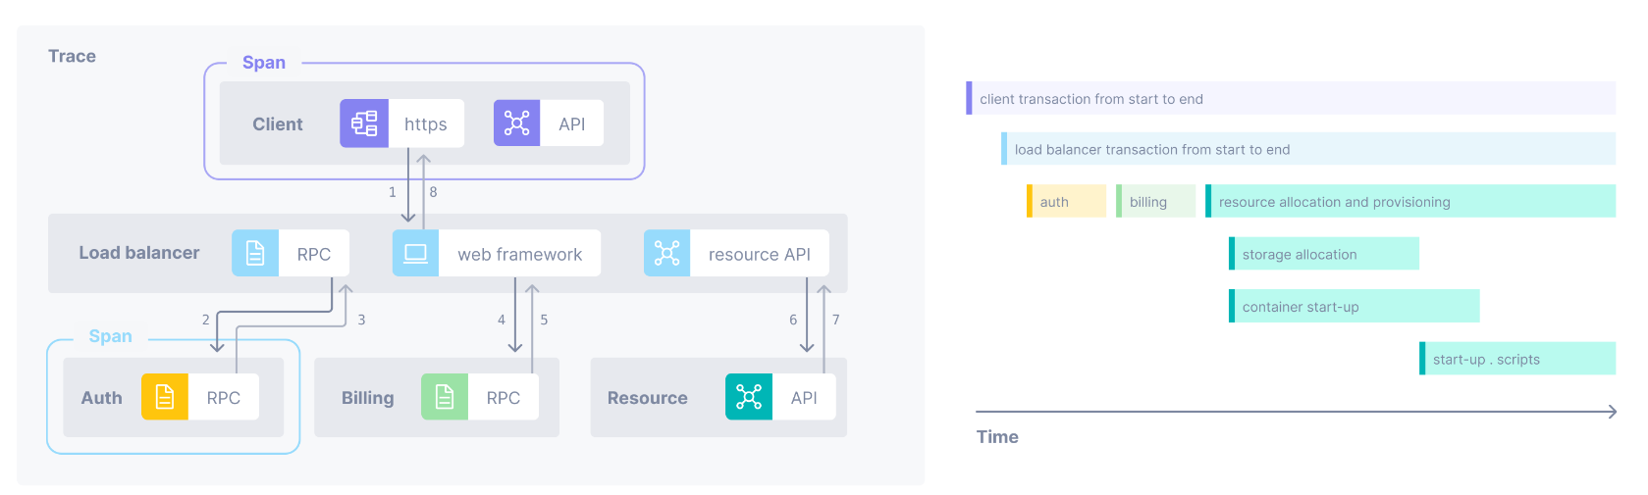
Tracing
Spring Cloud Sleuth provides Spring Boot auto-configuration for distributed tracing.
If this app calls out to another one (e.g. with RestTemplate) it will send the trace data in headers and if the receiver is another Sleuth app you will see the trace continue there.
Trace is a view into a request as it moves through a distributed system. Multiple spans represent different parts of the workflow and are pieced together to create a trace.
Span is a named, timed operation that represents a piece of the workflow.

Slide 12
References
https://www.slideshare.net/Pivotal/the-beginners-guide-to-spring-cloud
https://spring.io/projects/spring-cloud
https://www.slideshare.net/Pivotal/introduction-to-spring-cloud
https://www.youtube.com/watch?v=Dd9-UxrNiD0 (Consul)
https://spring.io/projects/spring-cloud-circuitbreaker
https://betterjavacode.com/programming/spring-retry-vs-resilience4j-retry
https://www.baeldung.com/spring-cloud-load-balancer
https://www.youtube.com/watch?v=r9nLJwinIvU (feign)
https://www.youtube.com/watch?v=EKoq98KqvrI (API Gateway)

